Slide 1

CSE3251
Computer Networks
Dr. Asif Zaman
Professor, CSE, RU

Slide 2
Internetworks
https://www.submarinecablemap.com/

Slide 3
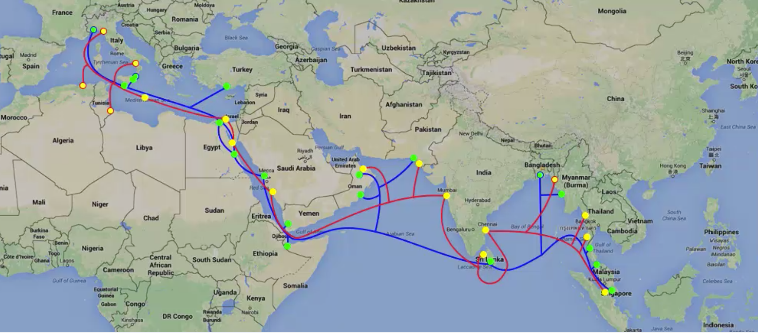
Internetworks

Slide 4
Network Software
The first computer networks were designed with the hardware as the main concern and the software as an afterthought.
This strategy no longer works.
To reduce their design complexity, most networks are organized as a stack of layers or levels, each one built upon the one below it.

Slide 5
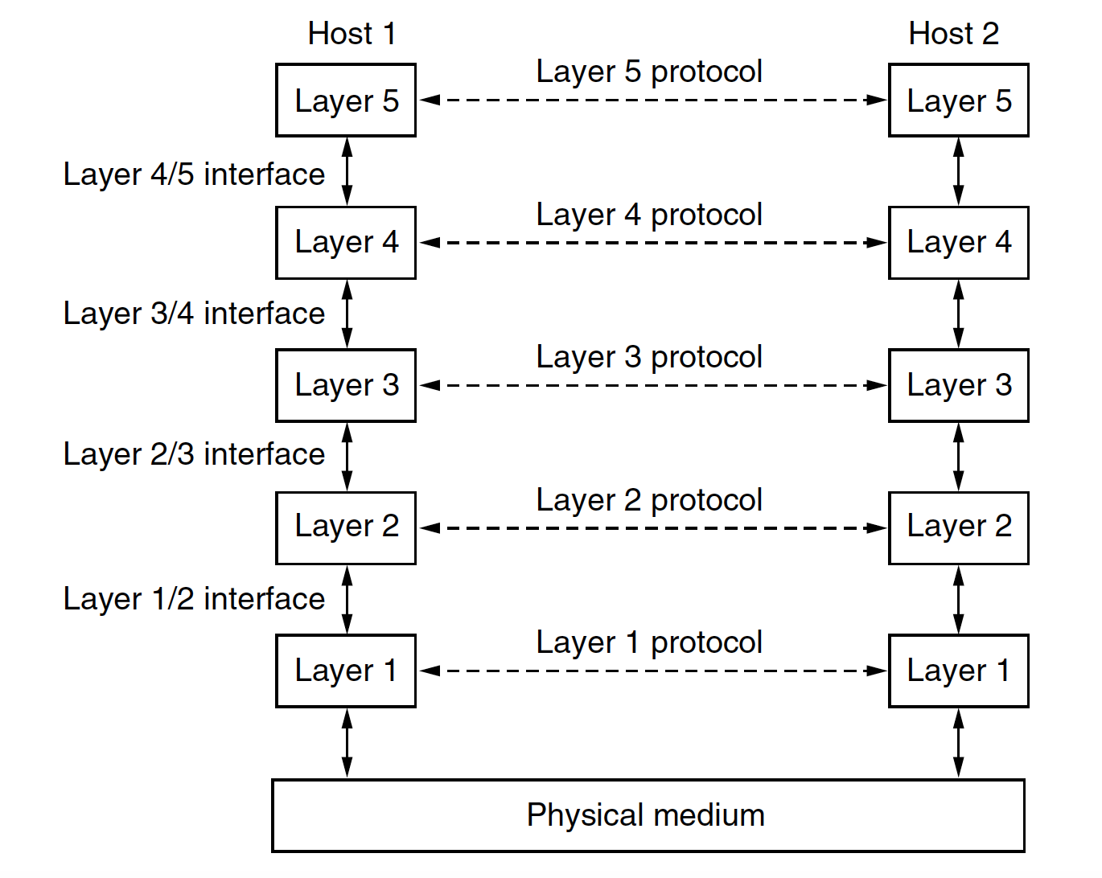
Network Software
A protocol is an agreement between the communicating parties on how communication is to proceed.
Peer – both host
A set of layers and protocols is called a network architecture.
A list of the protocols used by a certain system, one protocol per layer, is called a protocol stack.

Slide 6
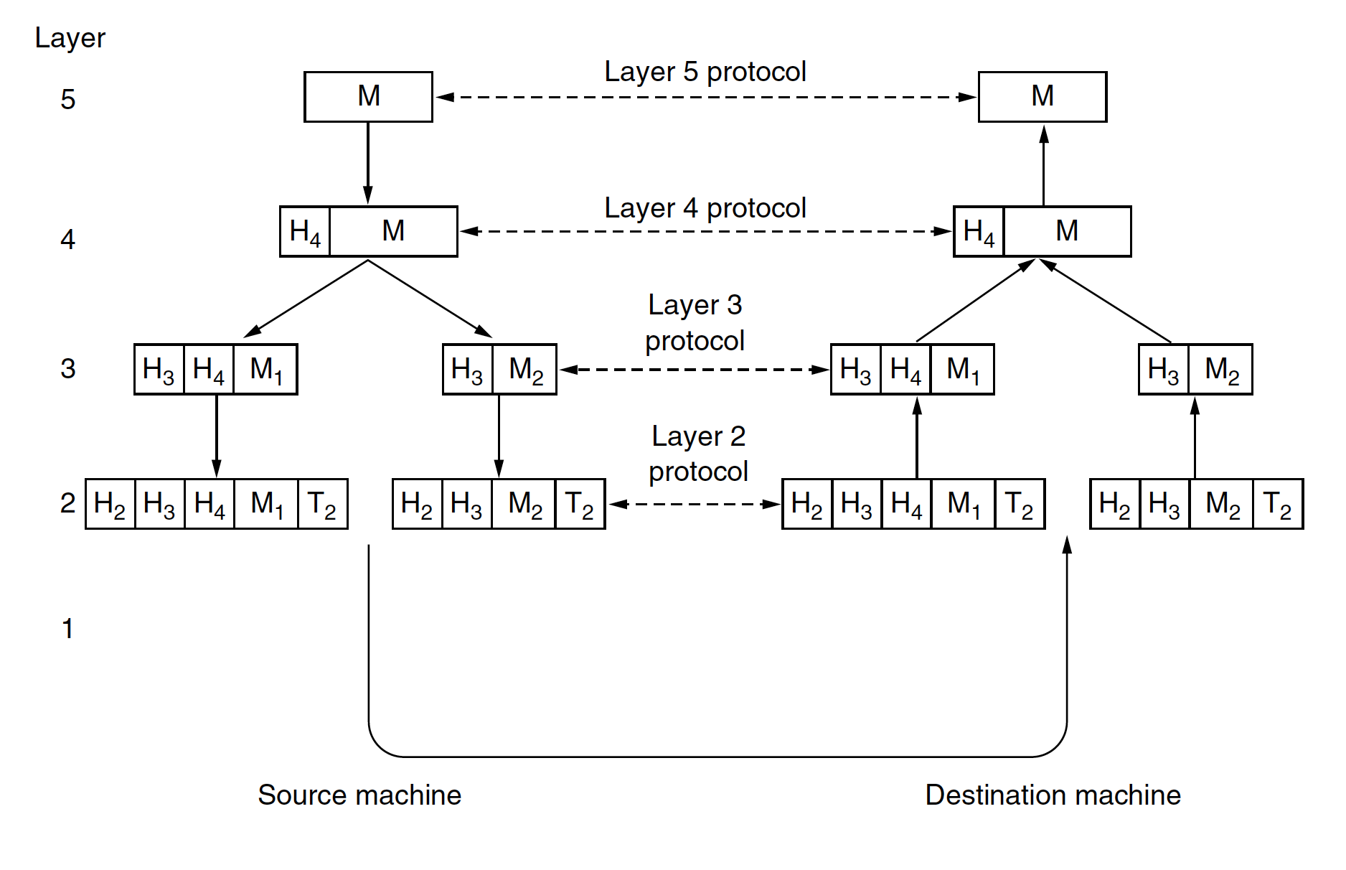
Network Software

Slide 7
Design Issues for the Layers
Reliability
uses codes for error detection.
error correction
They are used at low layers,
Routing
Finding a working path through a network
addressing or naming,
internetworking.

Slide 8
Design Issues for the Layers
Resource allocation.
Who will get priority
flow control.
Quality of service
Confidentiality
authentication
Integrity

Slide 9
Reference Models
Two Popular Reference models
OSI (Open Systems Interconnection)
protocols associated with the OSI model are not used any more, the model itself is actually quite general and still valid, and the features discussed at each layer are still very important
TCP/IP

Slide 10
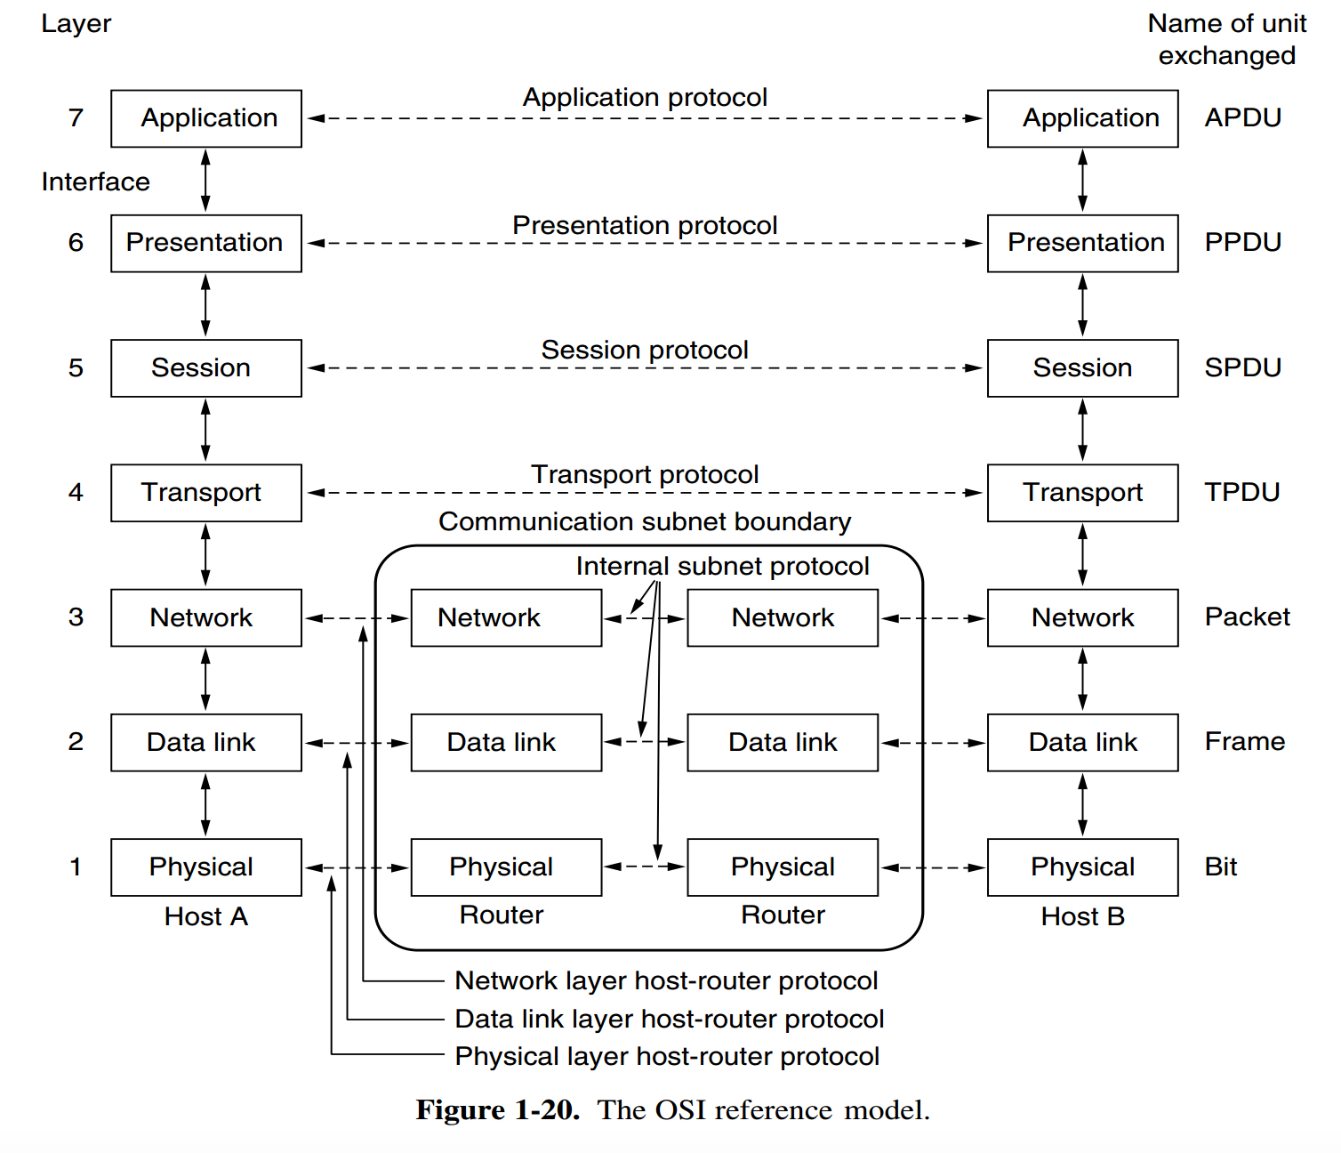
OSI Reference Model
All People Seem To Need Data Processing

Slide 11
The Physical Layer
The physical layer is concerned with transmitting raw bits over a communication channel.
The design issues have to do with making sure that
when one side sends a 1 bit it is received by the other side as a 1 bit, not as a 0 bit.
what electrical signals should be used to represent a 1 and a 0,
how many nanoseconds a bit lasts,
whether transmission may proceed simultaneously in both directions,
how the initial connection is established,
how it is torn down when both sides are finished,
how many pins the network connector has, and
what each pin is used for.

Slide 12
The Data Link Layer
The main task of the data link layer is to transform a raw transmission facility into a line that appears free of undetected transmission errors.
It accomplishes this task by having the sender break up the input data into data frames (typically a few hundred or a few thousand bytes) and transmit the frames sequentially.
The receiver confirms correct receipt of each frame by sending back an acknowledgement frame.

Slide 13
The Data Link Layer

Slide 14
The Network Layer
A key design issue is determining how packets are routed from source to destination.
More generally, the quality of service provided (delay, transit time, jitter, etc.) is also a network layer issue

Slide 15
The Transport Layer
The basic function of the transport layer is to:
accept data from above it,
split it up into smaller units if need be,
pass these to the network layer, and
ensure that the pieces all arrive correctly at the other end.

Slide 16
The Session Layer
The session layer allows users on different machines to establish sessions between them.
Sessions offer various services:
including dialog control (keeping track of whose turn it is to transmit),
token management (preventing two parties from attempting the same critical operation simultaneously), and
synchronization

Slide 17
The Presentation Layer
Unlike the lower layers, which are mostly concerned with moving bits around, the presentation layer is concerned with the syntax and semantics of the information transmitted.
In order to make it possible for computers with different internal data representations to communicate, the data structures to be exchanged can be defined in an abstract way, along with a standard encoding to be used ‘‘on the wire.’’
The presentation layer manages these abstract data structures and allows higher-level data structures (e.g., banking records) to be defined and exchanged

Slide 18
The Application Layer
The application layer contains a variety of protocols that are commonly needed by users.
One widely used application protocol is HTTP (HyperText Transfer Protocol), which is the basis for the World Wide Web.
When a browser wants a Web page, it sends the name of the page it wants to the server hosting the page using HTTP.
The server then sends the page back.
Other application protocols are used for file transfer, electronic mail, and network

Slide 19
OSI Reference Model

Slide 20
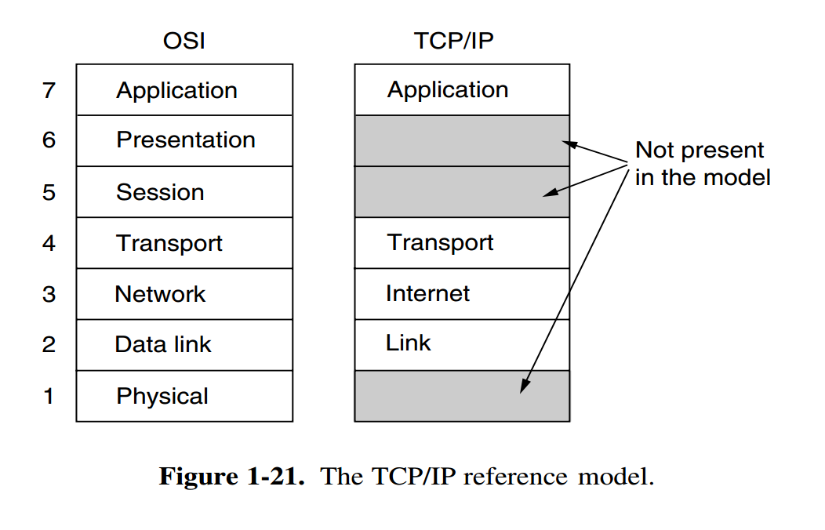
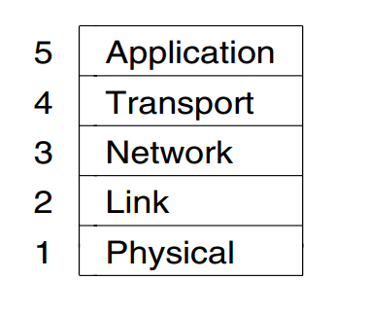
TCP/IP Reference Model

Slide 21
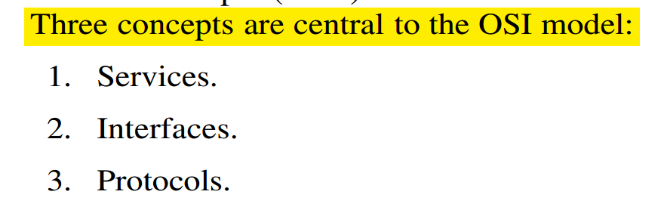
OSI Model

Slide 22
OSI Model
The service definition tells what the layer does, not how entities above it access it or how the layer works.
Layer’s interface tells the processes above it how to access it. It specifies what the parameters are and what results to expect.
Finally, the peer protocols used in a layer are the layer’s own business. It can use any protocols it wants to, as long as it gets the job done (i.e., provides the offered services). It can also change them at will without affecting software in higher layers.

Slide 23
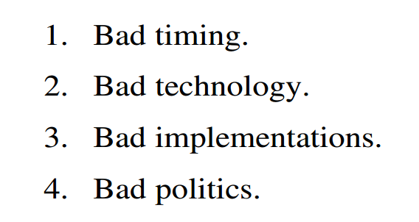
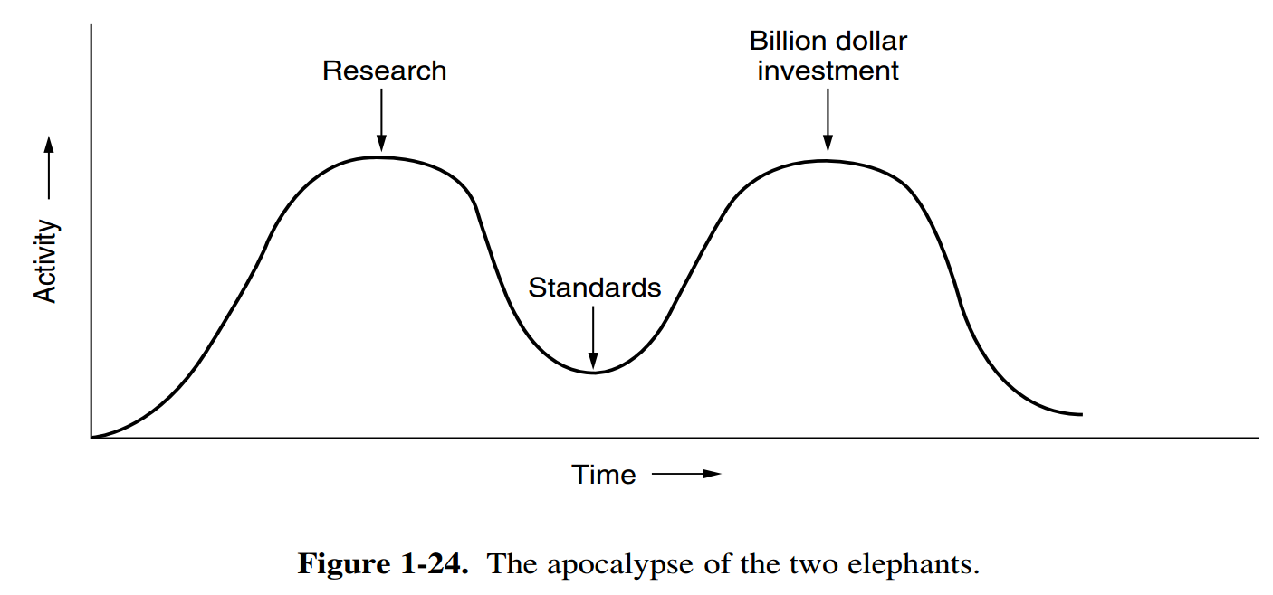
Why OSI Model Failed…
রহস্যউন্মোচন
David Clark of M.I.T. has a theory of standards that he calls the apocalypse of the two elephants

Slide 24
A Critique of the OSI Model
Bad Technology
The choice of seven layers was more political than technical, and two of the layers (session and presentation) are nearly empty,
Whereas two other ones (data link and network) are overfull
Bad Implementations
Given the enormous complexity of the model and the protocols, it will come as no surprise that the initial implementations were huge, unwieldy, and slow.
Bad Politics
TCP/IP: UNIX system… more popular academia
…be the creature European telecommunication ministries, the European Community, and later the U.S. Government

Slide 25
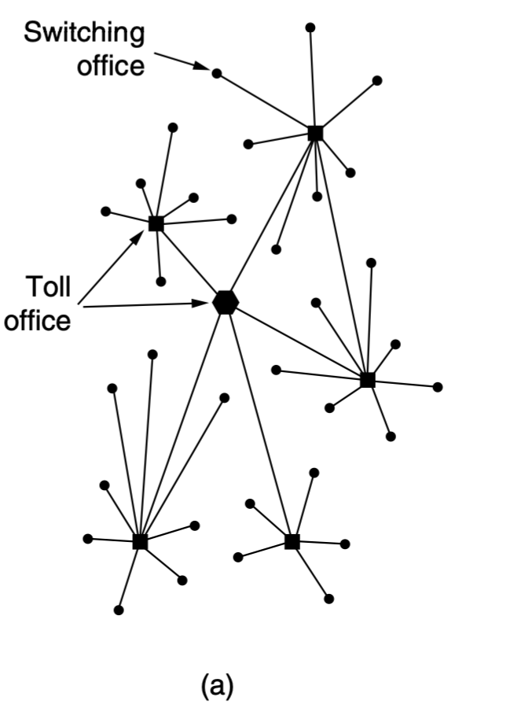
Example network: ARPANET
… the first operational computer network t… foundation of the modern internet
The story begins in the late 1950s.
… Cold War, the U.S. DoD wanted
a command-and-control network that could survive a nuclear war.
Around 1960, the DoD awarded a contract to the RAND Corporation to find a solution.

Slide 26
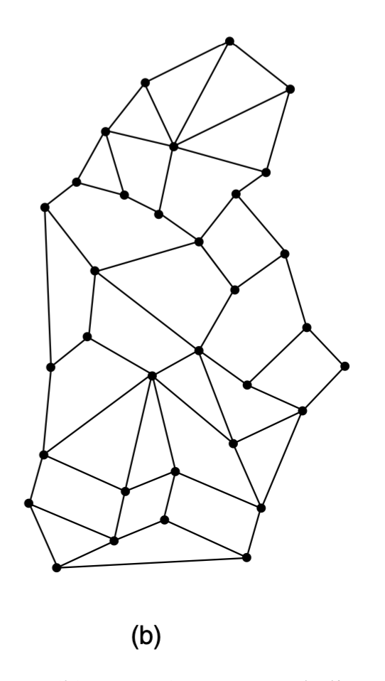
The ARPANET
Paul Baran proposed distributed switching system (Baran, 1964).
Officials at the Pentagon liked the concept and asked AT&T.
AT&T dismissed Baran’s ideas out ofhand

Slide 27
The ARPANET
US President …. to create a single defense research organization, ARPA, the Advanced Research Projects Agency.
ARPA had no scientists or laboratories; in fact, it had nothing more than an office and a small (by Pentagon standards) budget.
It did its work by issuing grants and contracts to universities and companies whose ideas looked promising to it.

Slide 28
The ARPANET
1967, Larry Roberts, a program manager at ARPA
ACM SIGOPS Symposium on Operating System Principles held in Gatlinburg, Tennessee in late 1967 (Roberts, 1967)…
… fully implemented under the direction of Donald Davies at the National Physical Laboratory (NPL) in England.
it cited Baran’s work
Roberts came away from Gatlinburg determined to build what later became known as the ARPANET

Slide 29
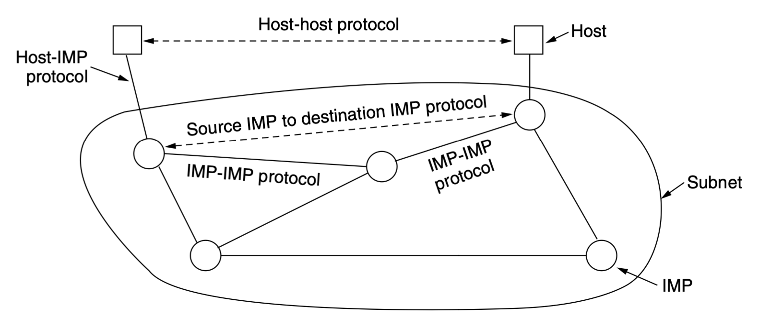
The ARPANET
… consist of minicomputers called IMPs (Interface Message Processors)
Connected by 56-kbps transmission lines.
For high reliability, each IMP would be connected to at least two other IMPs.
The subnet was to be a datagram subnet, so if some lines and IMPs were destroyed, messages could be automatically rerouted along alternative paths.

Slide 30
The software was split into two parts: subnet and host.
The subnet software consisted of the IMP end of the host-IMP connection, the IMP-IMP protocol, and
a source IMP to destination IMP protocol designed to improve reliability.

Slide 31
Each node of the network was to consist of an IMP and a host, in the same room, connected by a short wire.
A host … send messages … 8063 bits to its IMP, … break up … packets of at most 1008 bits and forward them independently toward the destination.
Each packet was received in its entirety before being forwarded.

